Slide 1


CROWD MANAGEMENT IN METRO STATION
Ideation Sprint | Year II & Semester IV
Student Name: ARVIND Roll No: 20BEE013 Team
Student Name: ARCHANA Roll No: 20BCS013 Name: C2_TEAM_15
Student Name: ASFAQ MOIDEEN Roll No: 20BEC015
Student Name: ANJANA PRASAD Roll No: 20BME013 Mentor
Student Name: DHARUN KUMAR Roll No: 20BCE013
Student Name: HARIPRASATH P Roll No: 20BTT013 Name: MANIMARAN D R (BIO-TECH)
ASSISTANT PROFESSOR(SRG)

Slide 2
Challenge
People around 23-39 died over a month due to the overcrowding
Time utilization
Authorization ,as it is a large scale project
Crowd managing
Location (indoor, outdoor, urban or rural)
CROWD MANAGEMENT

Slide 3
Significance
To ensure that a large gathering of people is controlled in an orderly and problem-free manner
A Steady flow of crowds. preventing excessively dense crowds.
Effective crowd management measures to increase the safety and throughput in train and metro stations.

Slide 4
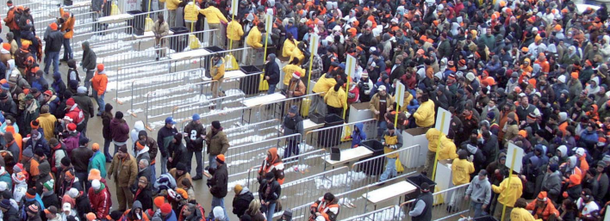
Target User
Passengers who travel day to day life.
Central and State Government
Public crowded areas.

Slide 5
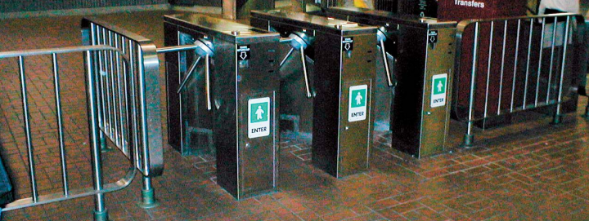
Use case
Passengers and Public crowd to get
Safe operation
Comfort Reliability
Punctuality

Slide 6
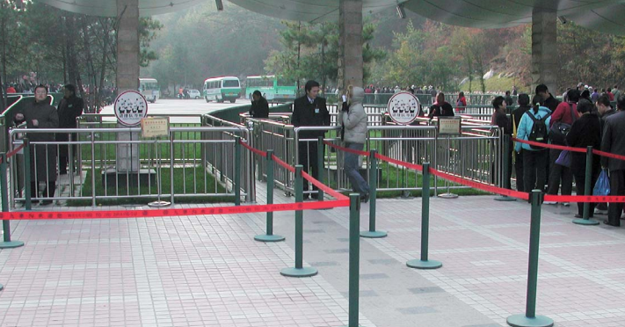
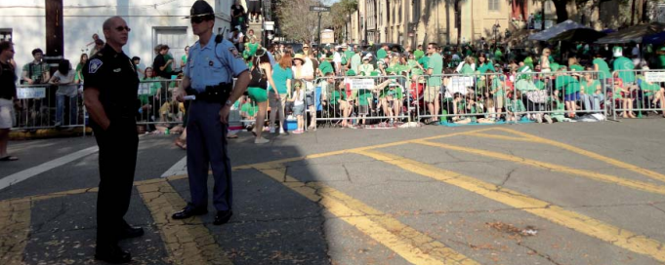
Existing Solutions
Queue Management
Temporary closures by physical security guards

Slide 7
Adoption Barriers
As it is a large scale project it need some central and state government support to authorize it .
There may cause some cost of issues in case any product damage
Maintainance & service Timings and charges

Slide 8
Value Proposition
Define the value proposition statement crafted for the target customer. Enumerate the benefits in terms of measurable outcomes or gains from solving the problem, and the pains that are relieved. Explain those specific gaps/challenges in the existing solutions that are being overcome and indicate in what other ways this solution is better than alternatives available today
Objectives behind it are:
To improve the safety
Increasing the reliability and punctuality
Increasing the comfort
Decreasing the travel times
Increasing shop and ticket revenues

Slide 9
Solution Concept (MUP)
Explain how your solution solves the problem in this specific use-case.
Explain how your solution delivers the outcomes or gains expected by the target user, and how it can be measured and proven.
Describe the minimum set of features and functionality required to meet the user's expectations, and to convince the target user to use and test your prototype.

Slide 10
Next Steps
Product development
Apply for funding
Patent Application

Slide 11
Thank You

